Slide 1
Writing Papers in the Biological Sciences
An introduction to Biological research and paper writing

Slide 2
Chapter Six: Documenting the Paper
Documentation:
What is a reference or citation?
Examples of citations
What is a reference style?
The Harvard Referencing style
CSE referencing style
Avoiding plagiarism

Slide 3
What is a reference or citation?
A way of giving credit for someone's thinking, writing or research
You mark the material when you use it (a citation) and give the full identification at the end (Reference).
In academic writing you are obliged to attribute every piece of material you use to its author.

Slide 4
Why cite or reference?
Credit sources of information & ideas
Reader can locate for further information if required
Validate arguments
Increase and spread knowledge
Show depth, breadth & quality of your reading!
Acknowledge the source of all material that is not your own.

Slide 5
Citation or reference style
A citation style or reference system is a standardised system for referring to materials used in your writing
There are several different citation styles developed independently by professional organisations.
University Departments generally stipulate which style to use for your subject.

Slide 6
The Harvard Referencing style
The most commonly used system in College/University.
Also known as the “author date system”
There are very specific rules for textual citations
There are very specific rules for listing your references at the end of your essay

Slide 7
CSE Style
Council of Science Editors (CSE: http://www.councilscienceeditors.org>)
CSE Name-Year System
Cite each reference by giving the name(s) of the author(s) followed by the year in which the material was published.
For each citation, use parentheses to enclose the name and the date.
If you are using the CSE name-year system, your references should be listed alphabetically according to the senior author’s last name.

Slide 8
CSE Style
In-Text Citations Be sure that every in-text citation has a corresponding entry in the reference list. (Exception: personal communications)
In-text citations (also known as parenthetical references) include the author's last name and year of the reference without a comma, e.g., (Smith 2011).
If there is no author, include the first word(s) of the title (enough to identify the source) followed by an ellipsis (...), e.g., (Biological research … 2007)

Slide 9
CSE Style
For 2 authors, list both last names in the in-text citation separated by “and” (NOT an ampersand “&”), e.g., (Haggarty and Gaynor 2008).
For more than 2 authors, list the first author’s last name followed by “et al.” and the year, e.g., (Coyne et al. 2001).
For different authors with the same last name, provide initials or enough other names to distinguish between them, e.g., (Smith BL 1999; Smith TD 2002)

Slide 10
CSE Style
Journal, Magazine, & Newspaper Articles:
Basic Format for Print Journals:
Author AA, Author BB. Date of publication. Article title. Journal Title. Volume (Issue): Page Numbers.
Basic Format for Online Journals:
Author AA, Author BB. Date of publication. Article title. Journal Title [Internet]. [Date cited]; Volume (Issue): Page Numbers. Available from: URL. DOI.
http://www.crossref.org....for all documenting styles

Slide 11
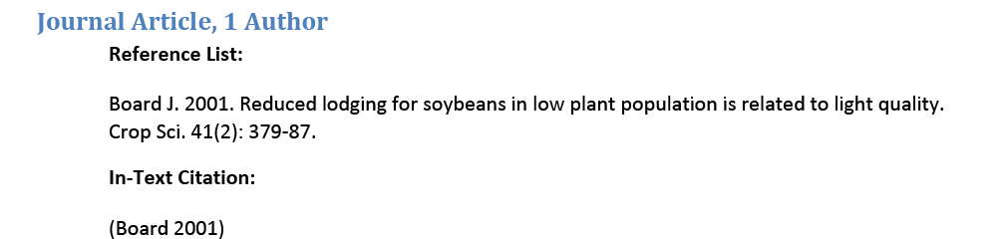
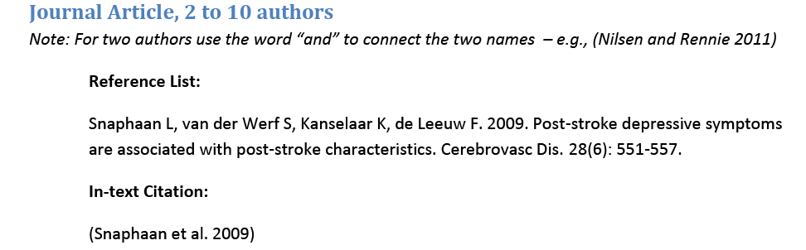
CSE Style

Slide 12
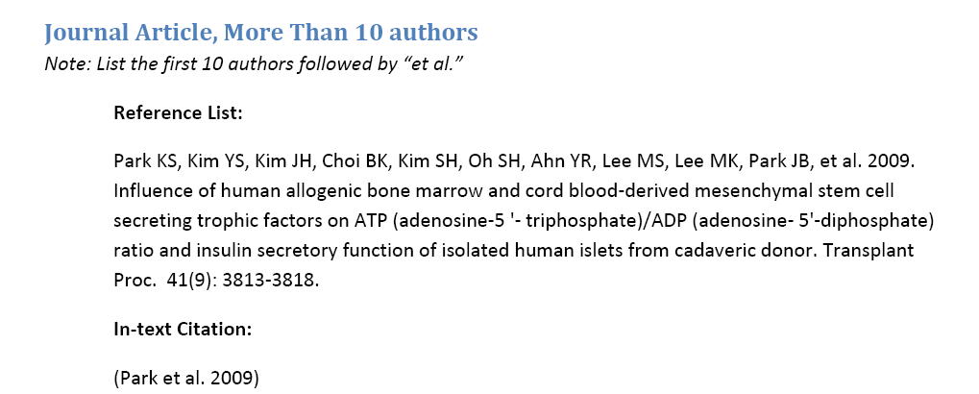
CSE Style

Slide 13
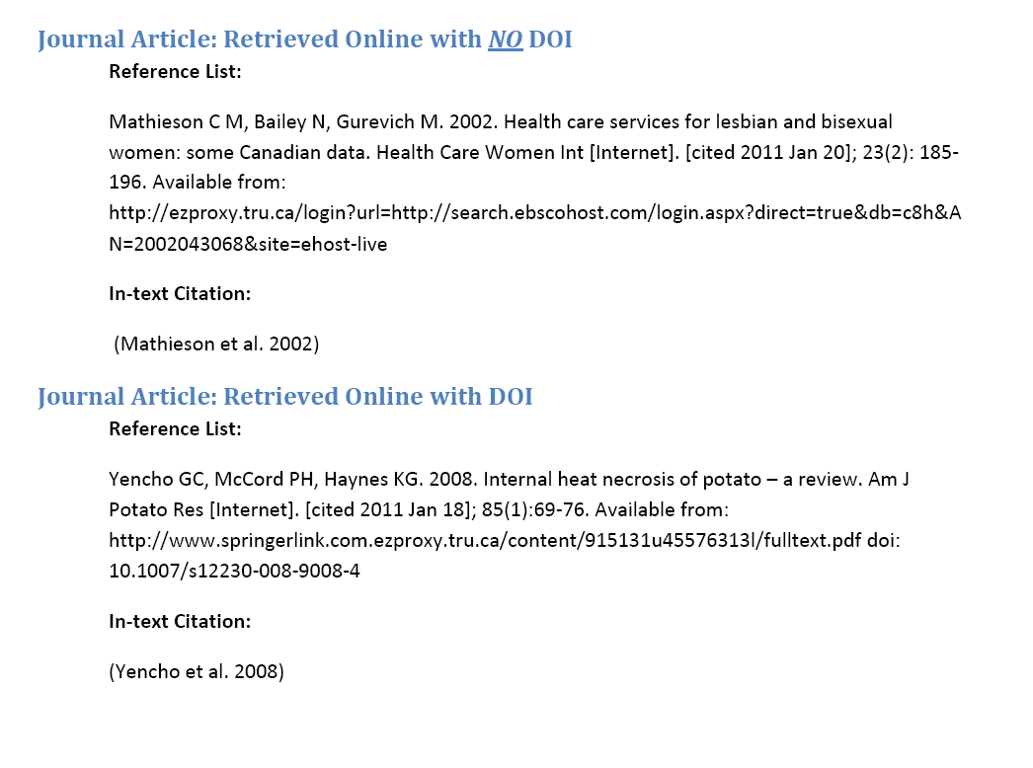
CSE Style

Slide 14
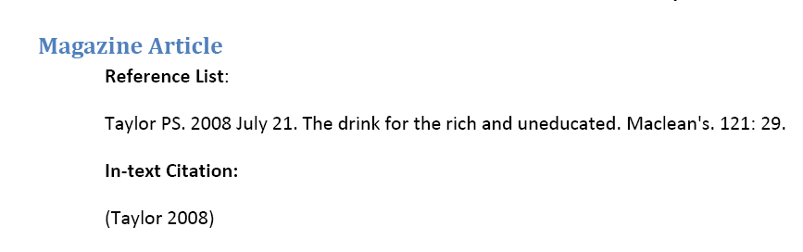
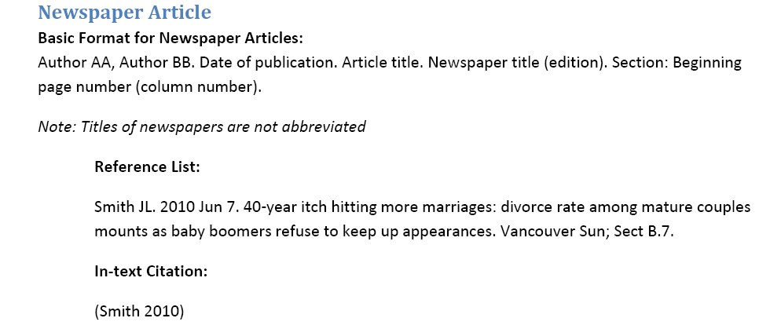
CSE Style

Slide 15
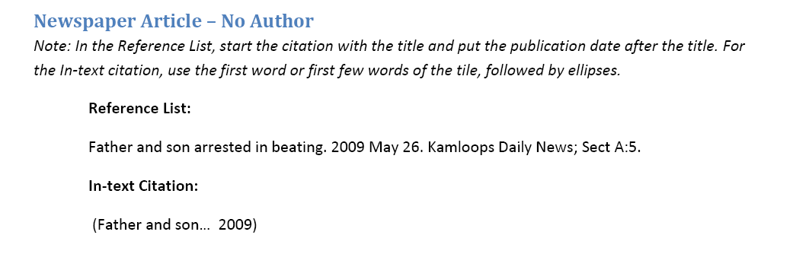
CSE Style

Slide 16
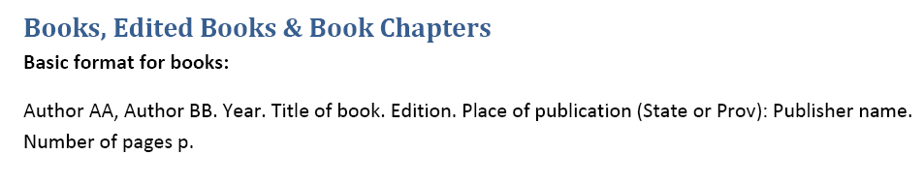
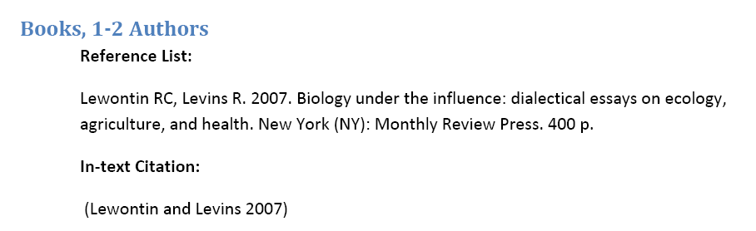
CSE Style

Slide 17
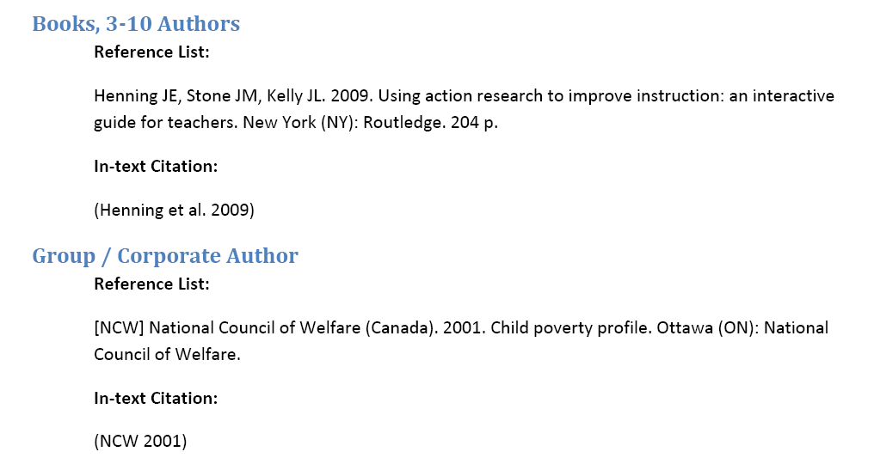
CSE Style

Slide 18
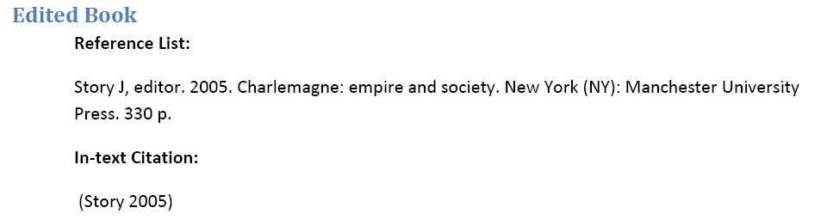
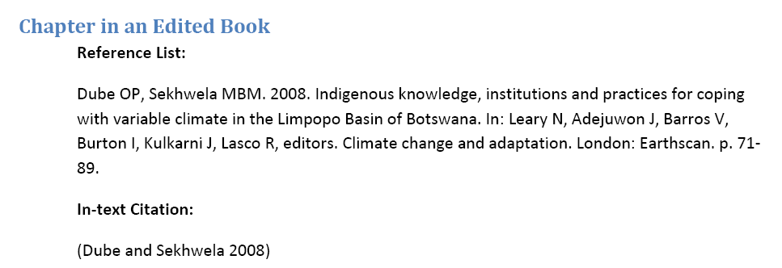
CSE Style

Slide 19
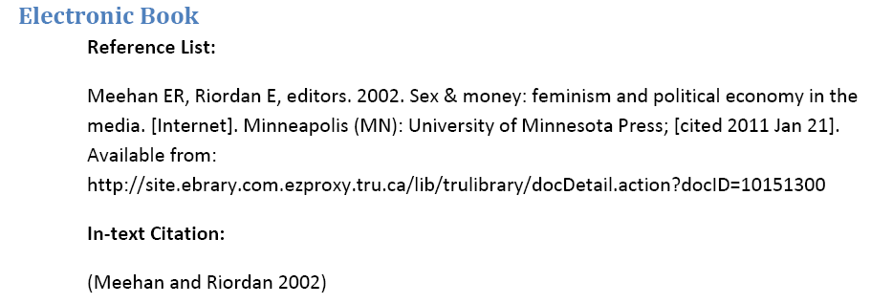
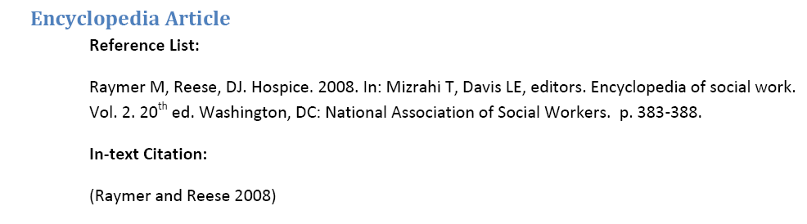
CSE Style

Slide 20
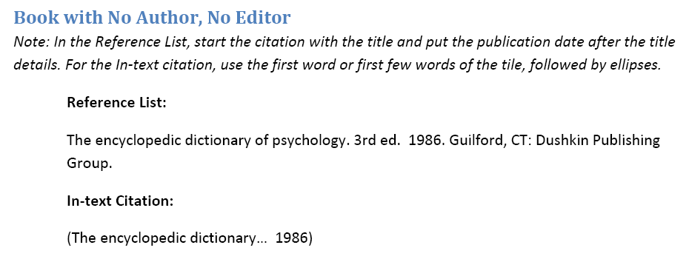
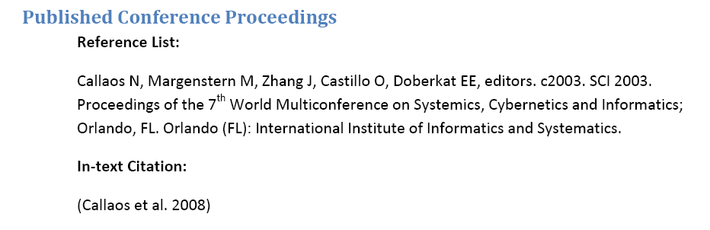
CSE Style

Slide 21
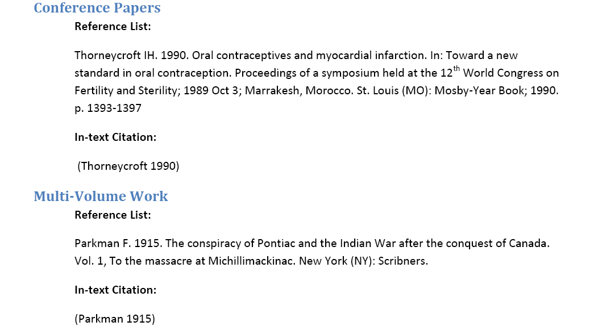
CSE Style

Slide 22
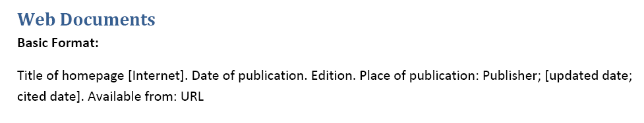
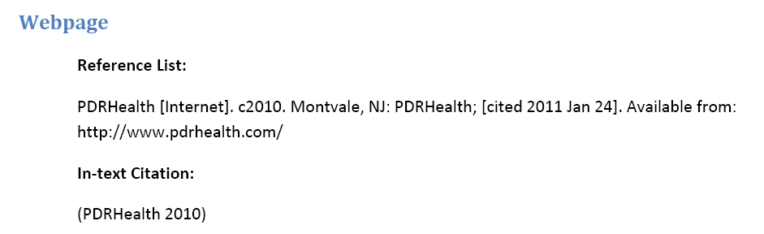
CSE Style

Slide 23
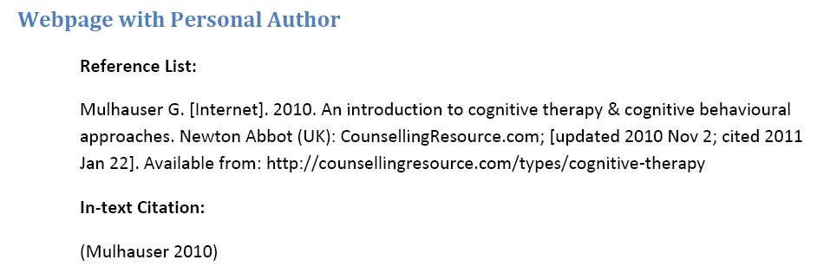
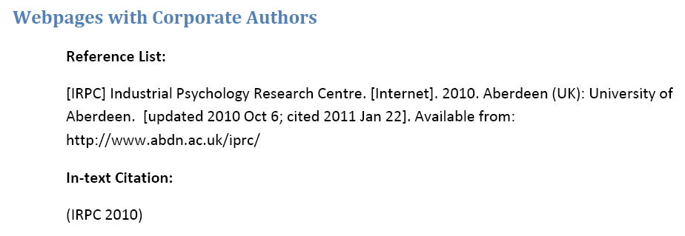
CSE Style

Slide 24
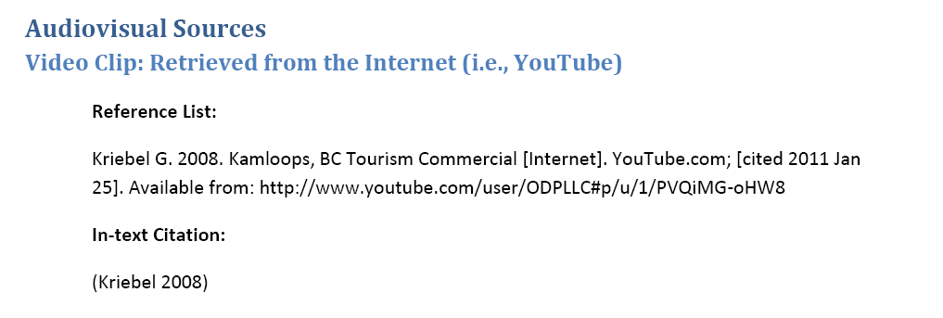
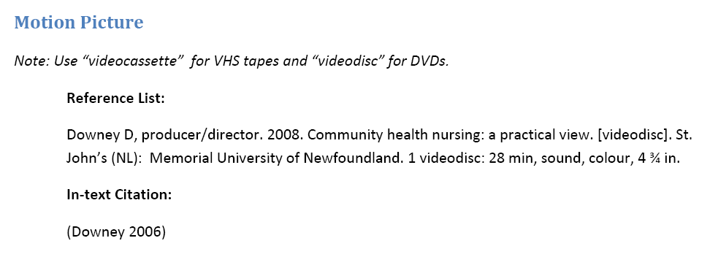
CSE Style

Slide 25
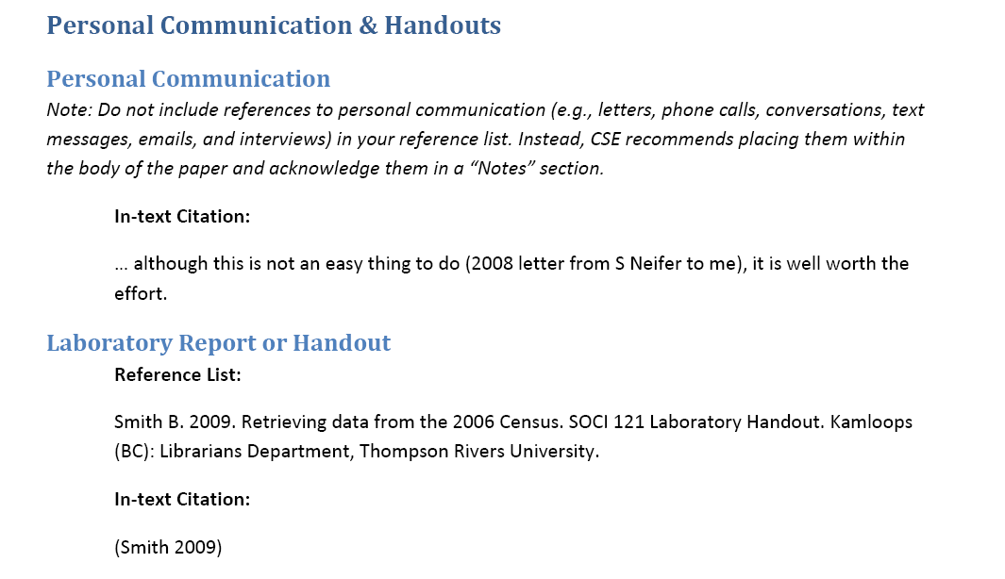
CSE Style

Slide 26
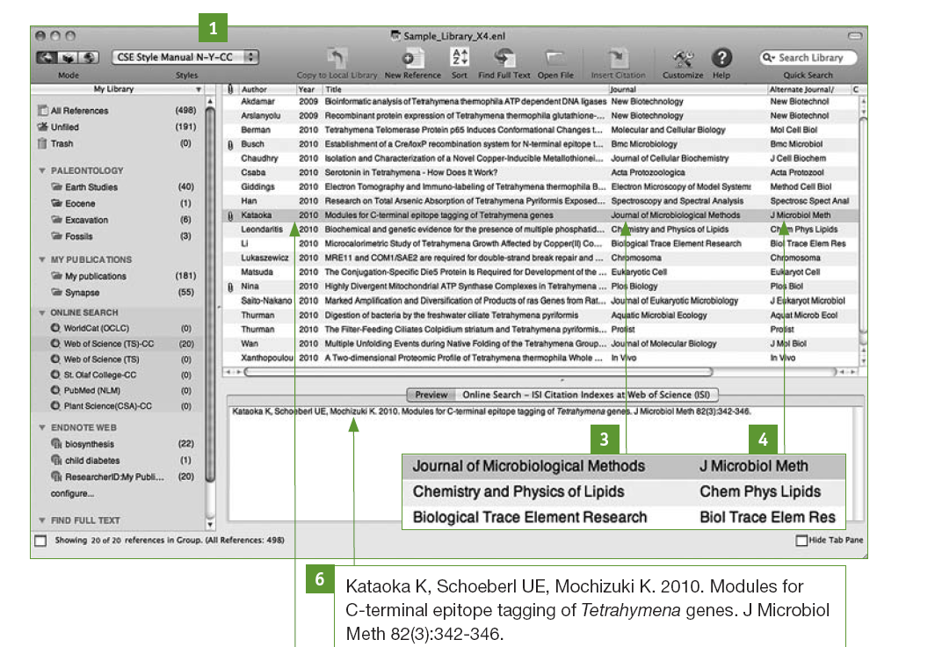

Slide 27
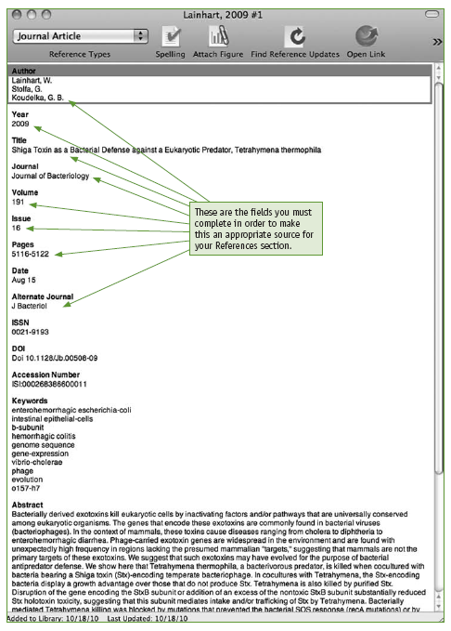

Slide 28
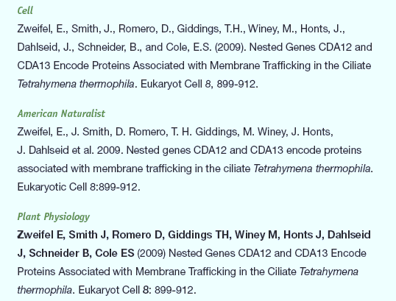

Slide 29
Avoiding plagiarism
The availability of text in digital form increases the possibility of accidentally using someone else's material without acknowledgement
Make sure you record all the details of the material you make notes on at the time so that you know who’s it is later
By all means use quotes and paraphrased material but cite it properly.
Proofread your reference list for accuracy, completeness, and consistency.

